Slide 1
Apriori Algorithm
By Parag Vyas

Slide 2
Presentation Overview
Apriori Review
Data Structures
Subset Function
Dataset
Results
References

Slide 3
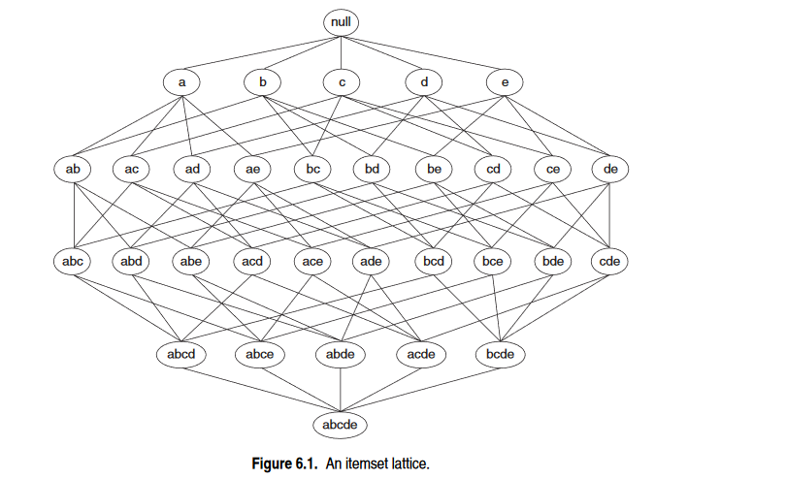
Apriori Principle
Tan (2018)

Slide 4
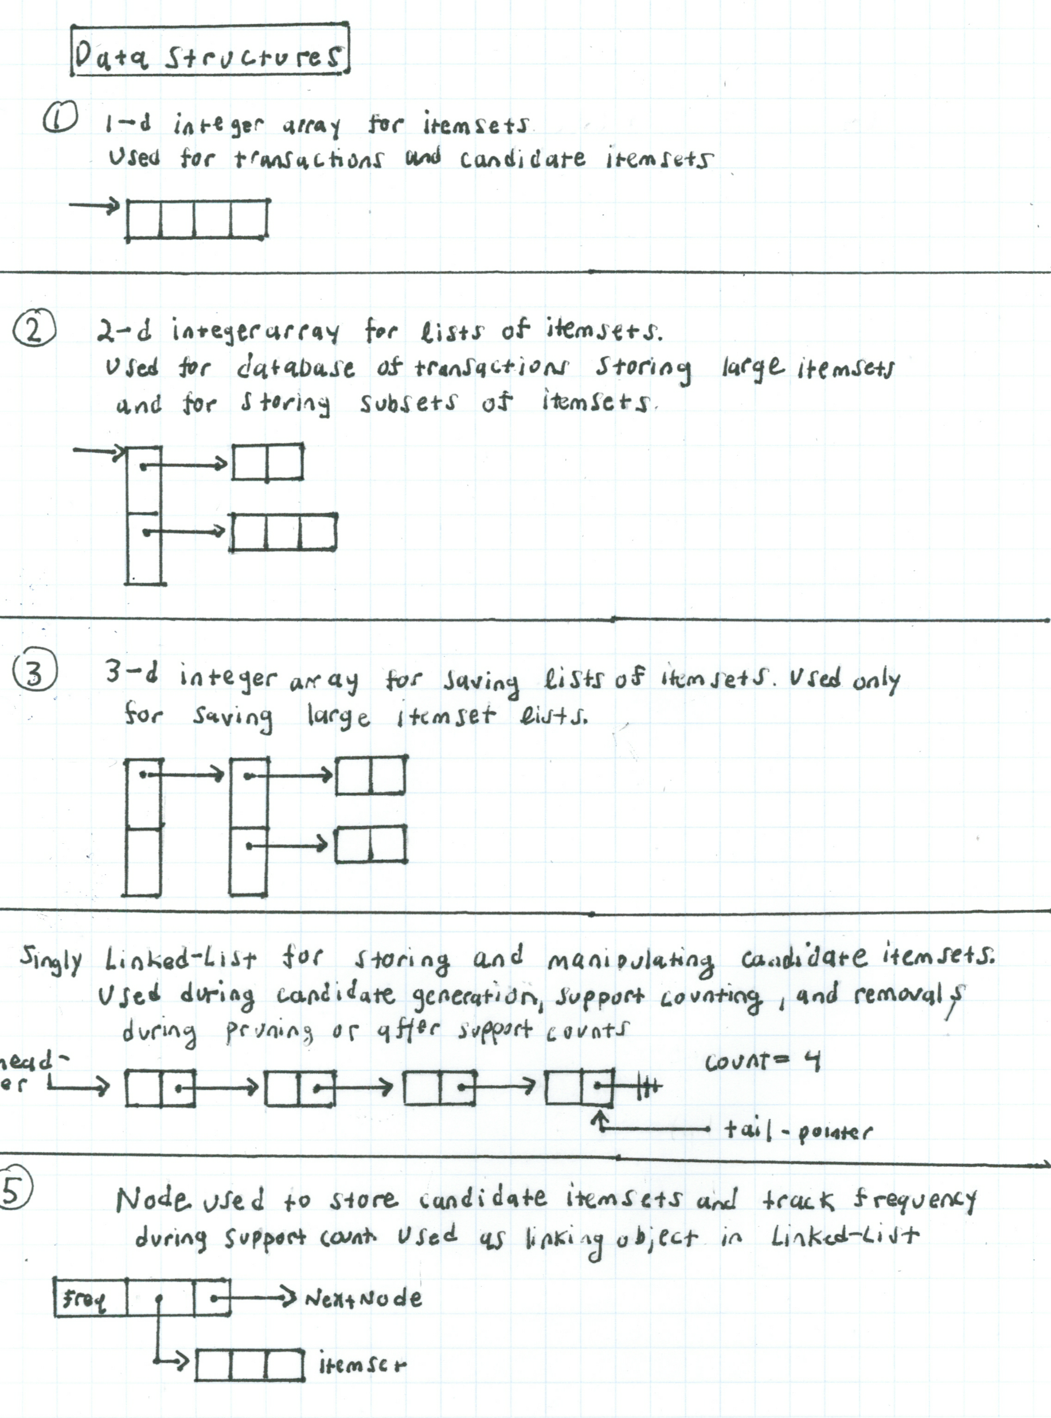
Data Structures
Arrays
Linked List

Slide 5
Sorted Itemsets
t = ( 3, 38, 103, 1001, 5343, 9999 )
t = ( 1, 2, 3, 4, 5, 6)

Slide 6
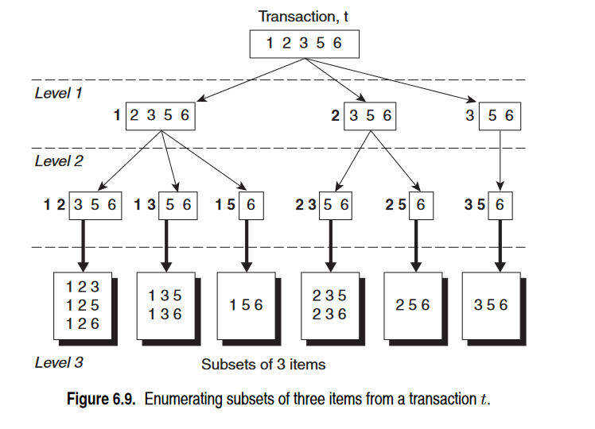
Prefix Tree
Tan (2018)

Slide 7
public int subsetIndices(int _nSize, int _kDepth, int _currLevel, int _inputEdge,
int _rowIndexEdge, int[][]destArr, int[]fixedList)
throws ArrayIndexOutOfBoundsException{
if(_currLevel == _kDepth){
fixedList[_currLevel-1] = _inputEdge;
for(int nloops = 0; nloops < fixedList.length; nloops++)
destArr[_rowIndexEdge][nloops] = fixedList[nloops];
return _rowIndexEdge + 1;
}
else{
if(_currLevel > 0){
fixedList[_currLevel-1] = _inputEdge;
}
int start = _inputEdge;
int nextNum = start;
int end = (_nSize - _kDepth) + _currLevel;
while(start <= end){
nextNum++;
_rowIndexEdge = subsetIndices(_nSize, _kDepth, (_currLevel + 1),
nextNum, _rowIndexEdge, destArr,
fixedList);
start++;
}
}
return _rowIndexEdge;
}
Base Case 1
Subset Finished
Recursive Step
Base Case 2
All output edges finished

Slide 8
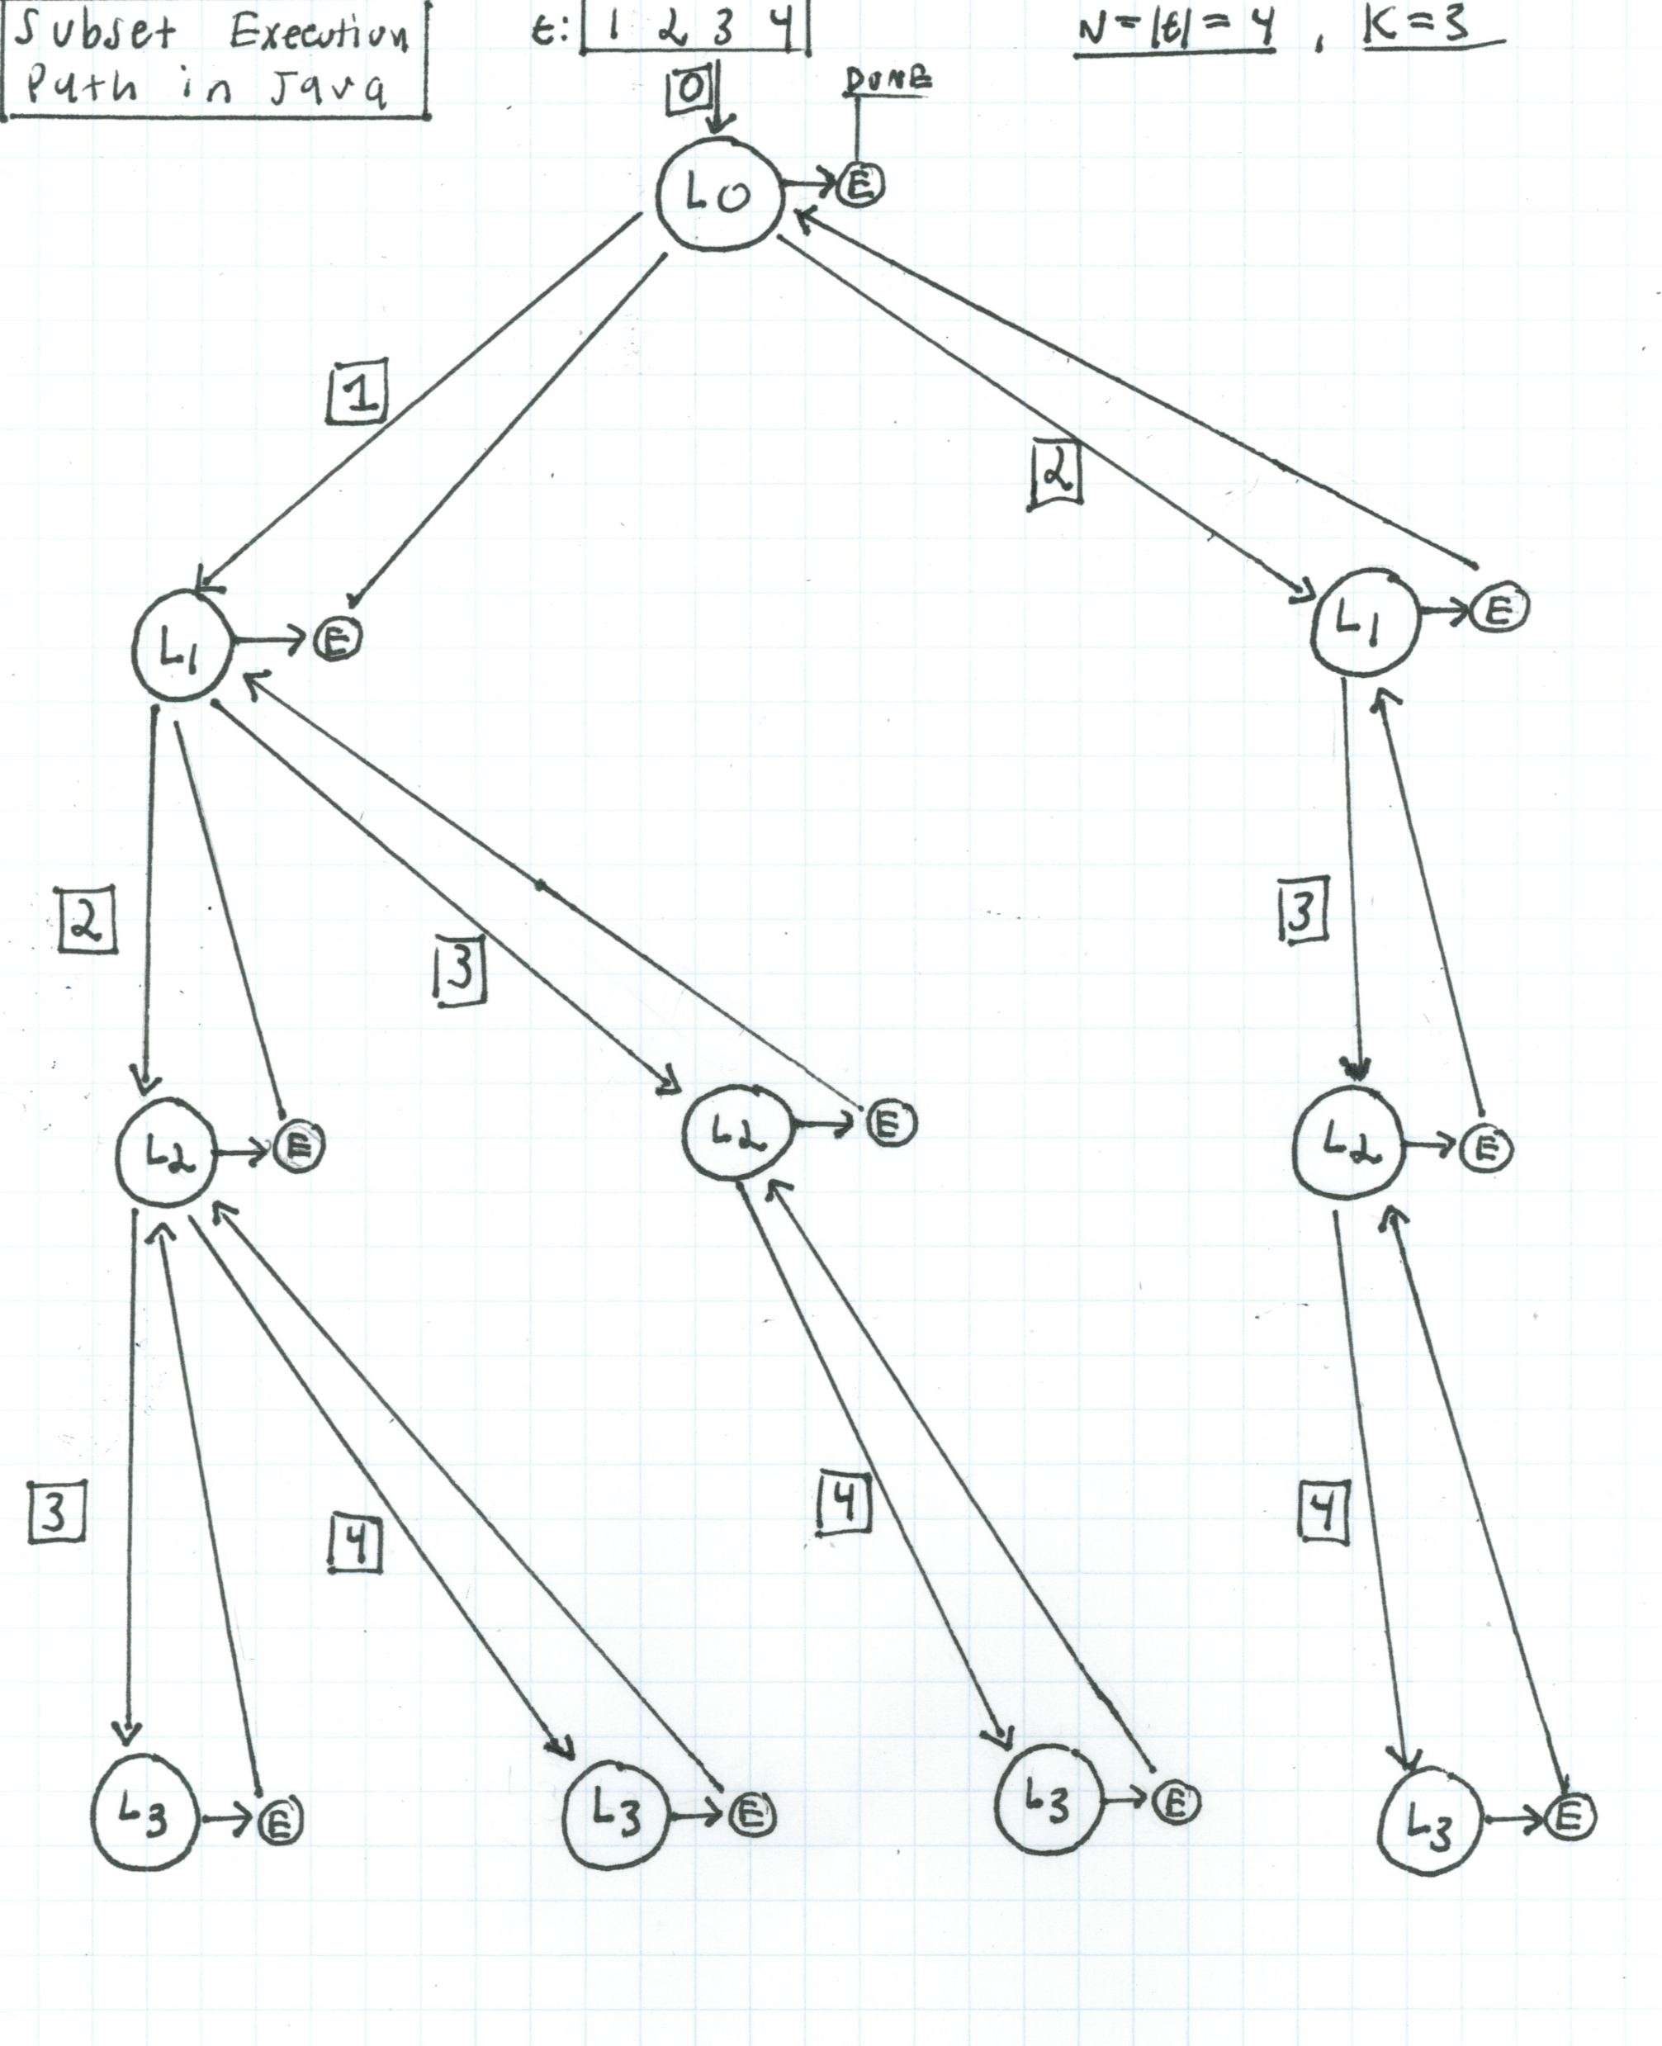

Slide 9
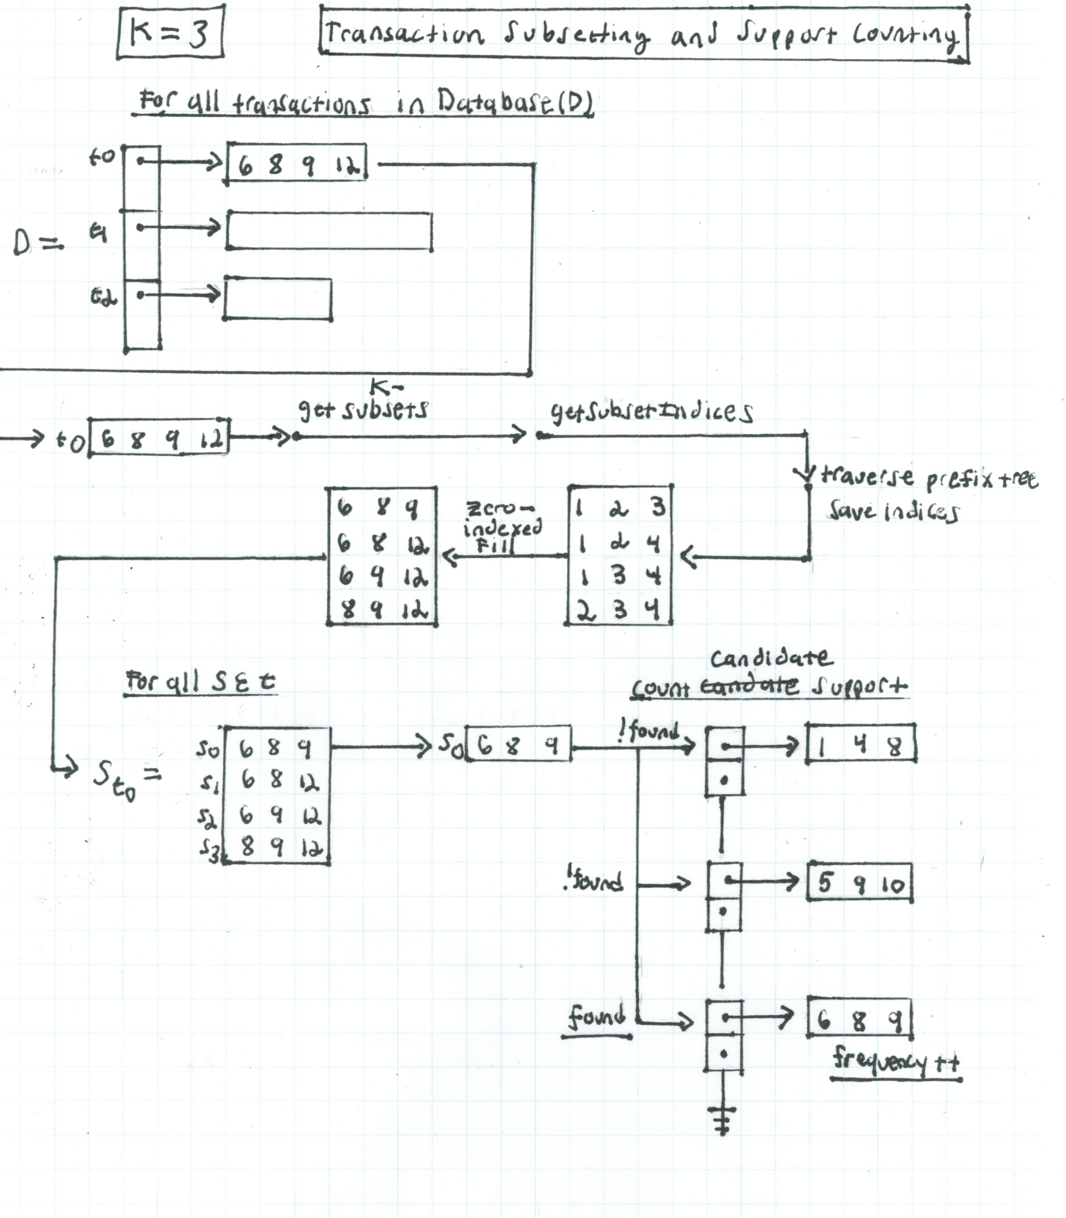
Support Counting

Slide 10
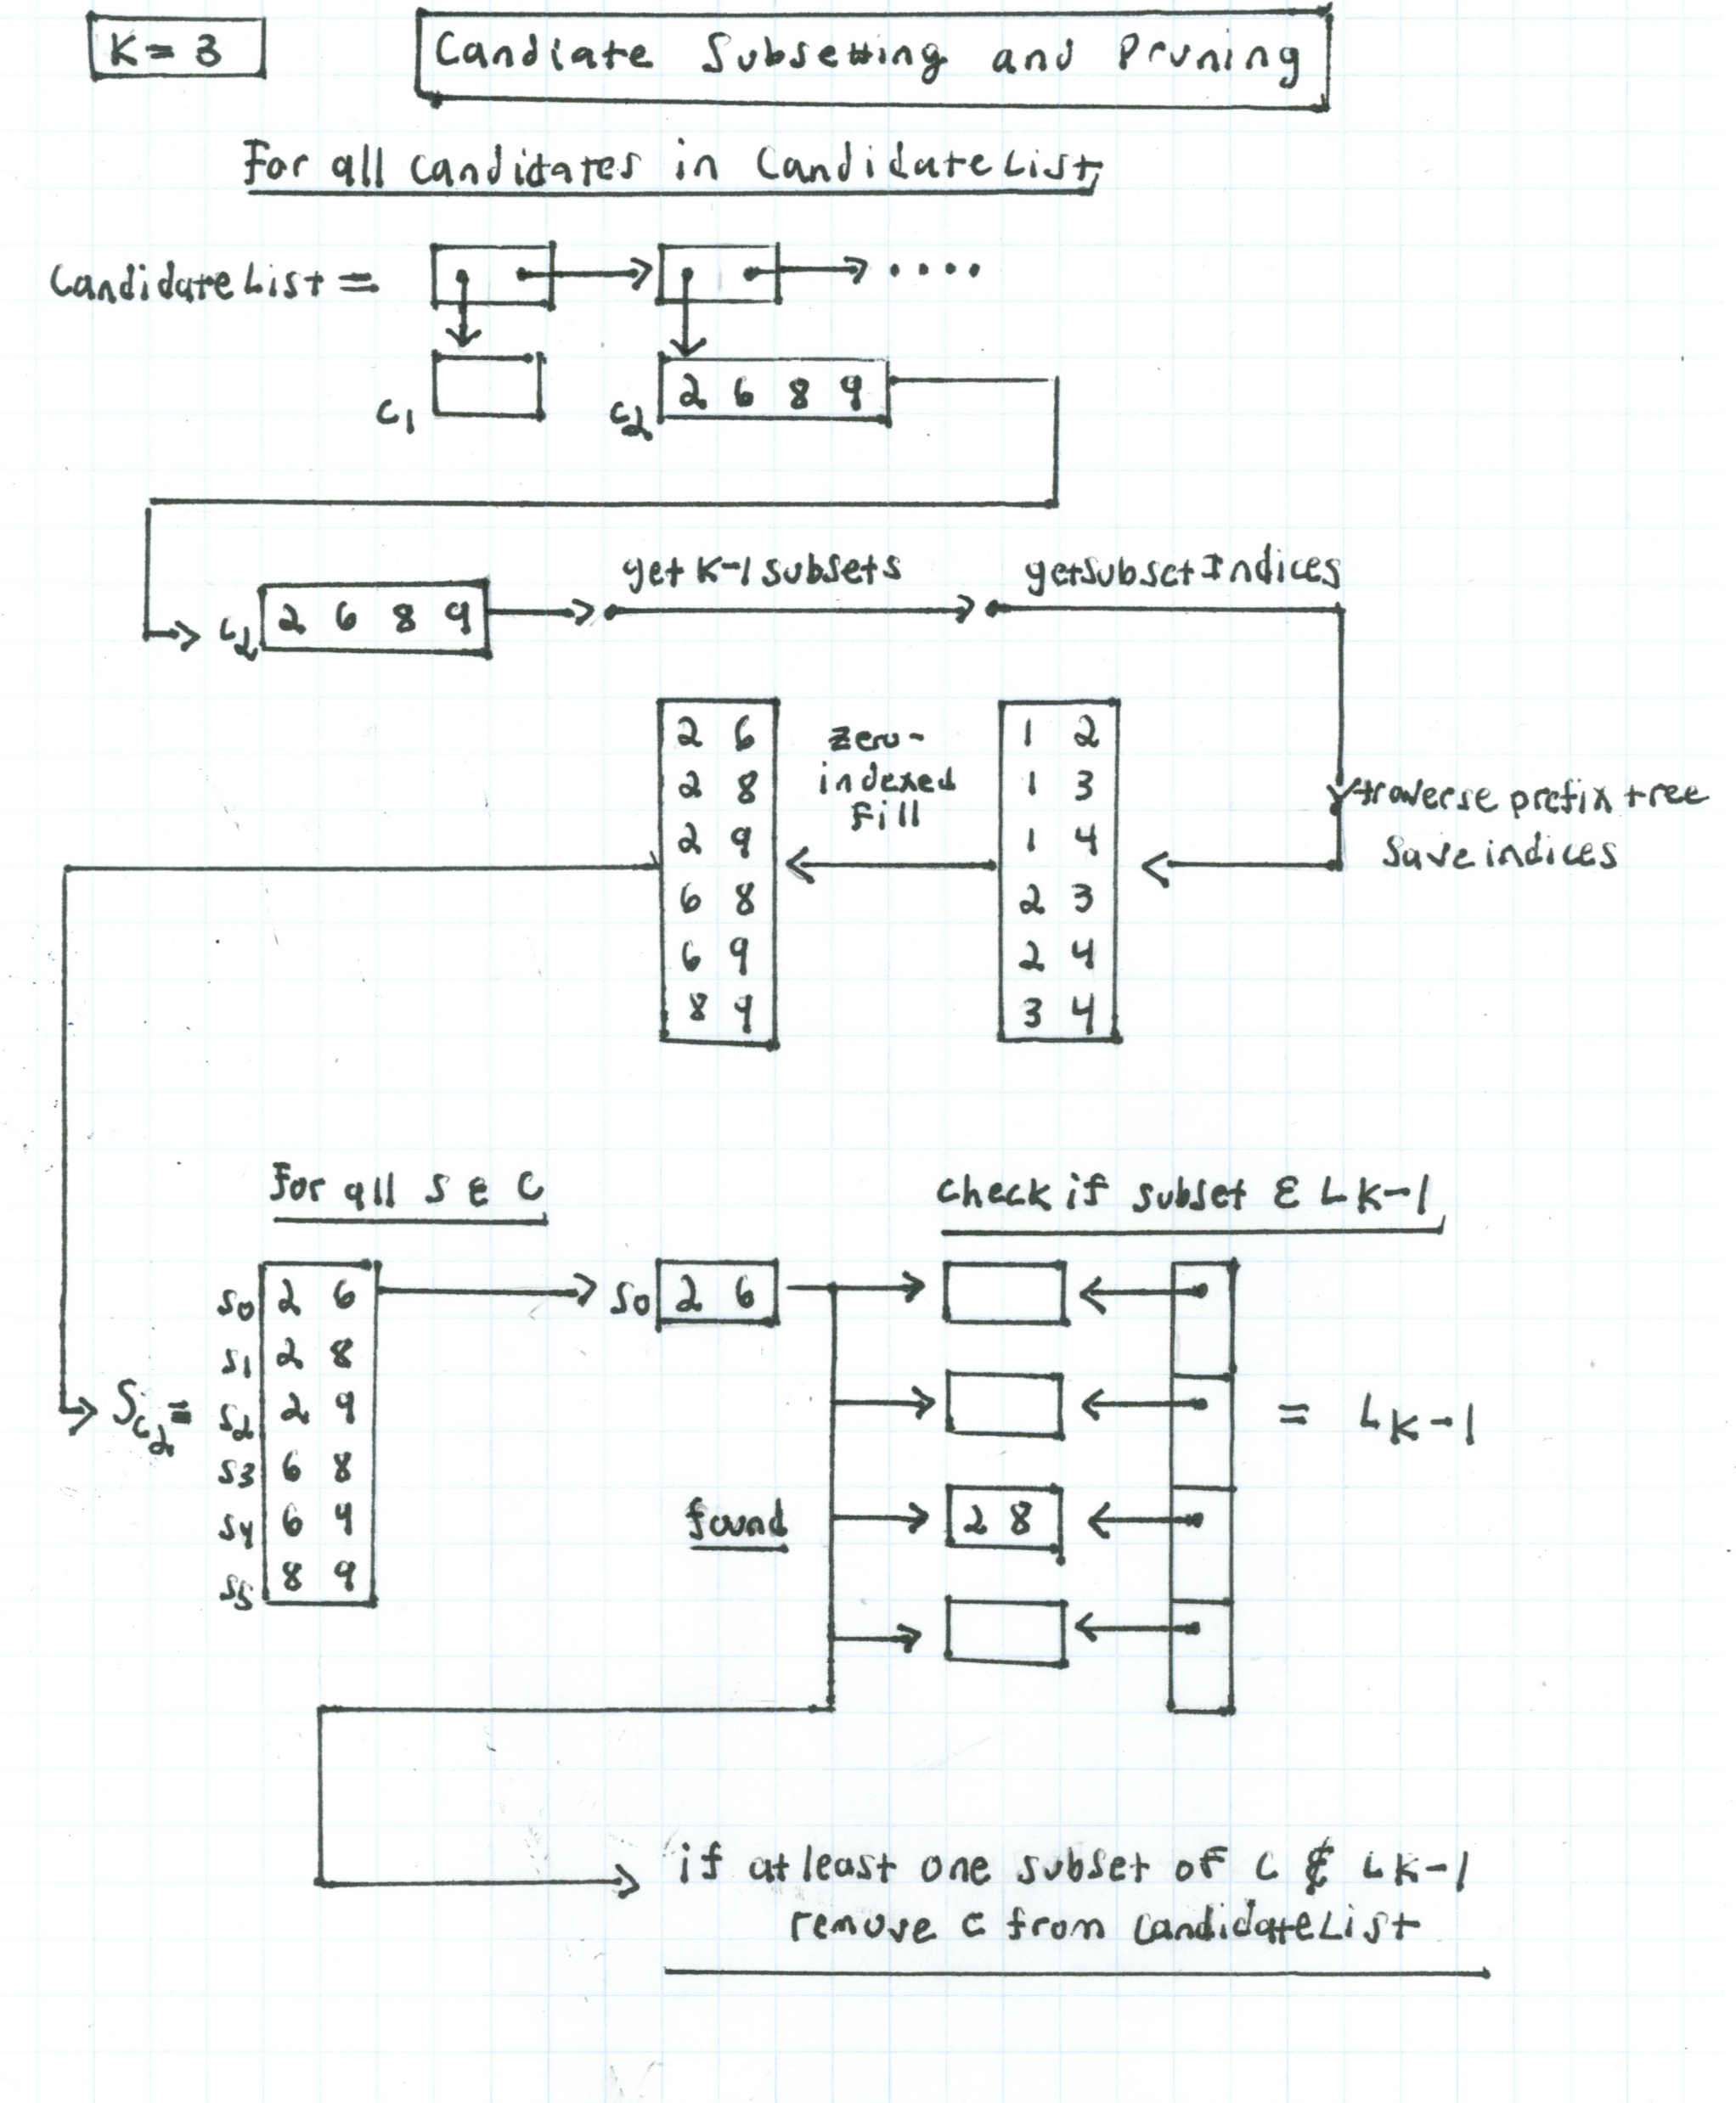
Pruning

Slide 11
Dataset - T10I4D100K
Synthetically created
Presorted
Total transactions: 100,000
Total items: 1,110,228
Item value range: 0 – 999
Max transaction width: 29
Average transaction width: 10
Storage using integers: 4.5 MB
25 52 164 240 274 328 368 448 538 561 630 687 730 775 825 834
39 120 124 205 401 581 704 814 825 834
35 249 674 712 733 759 854 950
39 422 449 704 825 857 895 937 954 964
15 229 262 283 294 352 381 708 738 766 853 883 966 978
26 104 143 320 569 620 798
7 185 214 350 529 658 682 782 809 849 883 947 970 979
227 390

Slide 12
Results
Minimum support = 0.5
Minimum support count = 500
Total large 1-itemsets: 568
Total large 2-itemsets: 341
Total large 3-itemsets: 116
Total large 4-itemsets: 42
Total large 5-itemsets: 9
Execution time: 25 minutes
Large 5-itemsets
( 33 217 283 346 515 )
( 208 290 458 888 969 )
( 217 546 661 923 947 )
( 350 411 572 579 803 )
( 350 411 572 579 842 )
( 350 411 572 803 842 )
( 350 411 579 803 842 )
( 350 572 579 803 842 )
( 411 572 579 803 842 )

Slide 13
References
Agrawal, Rakesh, and Ramakrishnan Srikant. “Fast Algorithms for Mining Association Rules in Large Databases.” In Proceedings of the 20th International Conference on Very Large Data Bases, 1994, pp. 487–499. ACM Digital Library.
Chung, Soon M. “Frequent Pattern Analysis.” 2018, Fairborn, Ohio, Wright State University.
Tan, Pang-Ning, et al. Introduction to Data Mining. Pearson Education, 2018.

